Slide 1
The Field of Data Science
Deep Learning
Shahriar’s Analytical Academy

Slide 2
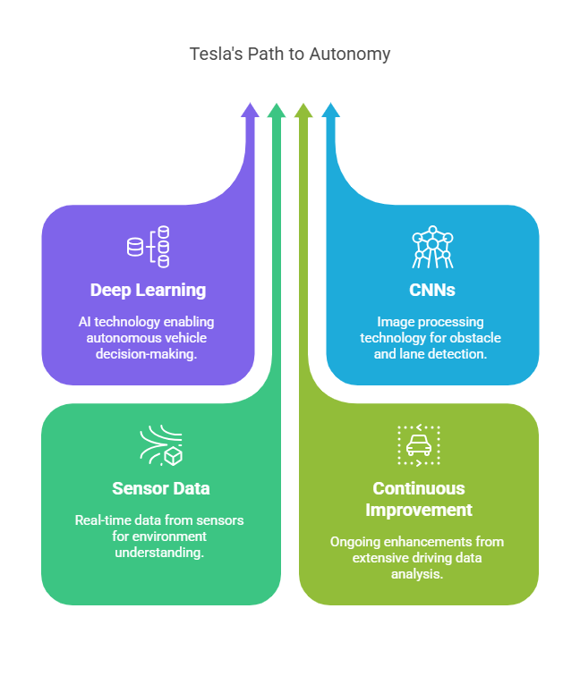
Definition and Example
Tesla’s Path to Autonomy
Deep Learning (DL) is a subset of Machine Learning (ML) that uses neural networks with many layers (hence the term "deep") to model complex patterns in large datasets.
It simulates the way the human brain works to recognize patterns, make decisions, and perform tasks. It involves training artificial neural networks on massive datasets to learn from data without explicit programming.
Notes:
Deep Learning (DL) is a part of Machine Learning (ML) that focuses on using artificial neural networks with many layers. These layers are responsible for analyzing and understanding complex patterns in huge amounts of data. The word “deep” refers to the many layers of these neural networks, which help process information in a way that mimics how the human brain works. Deep learning allows computers to recognize patterns, make decisions, and perform tasks without needing to be specifically programmed for every task. Instead, it learns from large datasets and improves its performance over time as it gets more data. Think of it like teaching a machine by showing it examples, so it can figure out how to do things on its own.
Example Scenario:
Company Example: Tesla's Autonomous Driving System
Tesla is a company that uses deep learning in their AI projects, particularly for their self-driving cars. These cars need to understand the world around them to drive safely. To achieve this, Tesla uses a specific type of neural network called Convolutional Neural Networks (CNNs). These networks help the car analyze images from cameras, radars, and other sensors to recognize important things like other cars, pedestrians, and lane markings on the road.
Every time a Tesla car drives, it collects data about its surroundings. This data helps improve the deep learning system, so the car gets better at driving and recognizing objects. As Tesla cars have been driving millions of miles, they continuously feed more data into the deep learning model. This process of constant improvement allows the car to become more accurate over time, making the autonomous driving system safer and smarter.

Slide 3
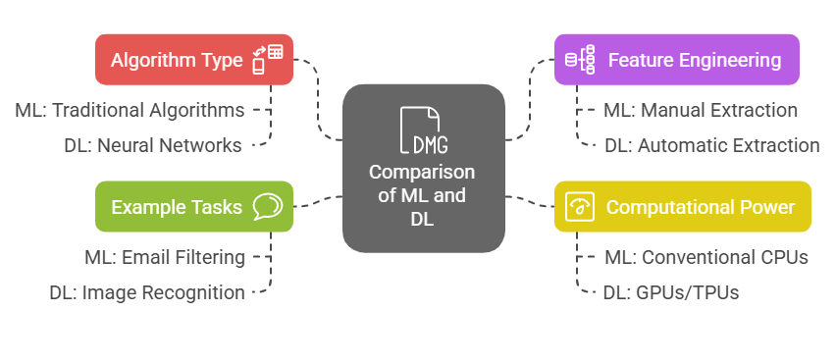
Machine learning v/s Deep learning
Notes:
Algorithm Type:
In Machine Learning (ML), traditional algorithms are used, such as Decision Trees, Random Forest, and Support Vector Machines (SVM). These algorithms analyze data and make predictions or decisions based on patterns they identify. In Deep Learning (DL), the focus shifts to neural networks, which are structured with many layers to model more complex patterns in the data. DL uses deep networks, meaning multiple layers of neurons are involved in the analysis, enabling it to handle more intricate problems.
Data Dependency:
Machine Learning (ML) generally works well with smaller datasets and does not require a huge amount of data to perform effectively. On the other hand, Deep Learning (DL) thrives on large datasets. To capture intricate patterns and achieve high performance, DL needs massive amounts of data. This is because DL models learn more by observing data over time, and the larger the dataset, the more accurately it can model complex relationships within the data.
Feature Engineering:
In Machine Learning (ML), manual feature extraction and selection are crucial steps. This means that experts need to define which aspects of the data are important and should be used in the model. Domain knowledge is important here to identify relevant features. However, in Deep Learning (DL), the model can automatically extract features directly from raw data. This significantly reduces the need for experts to handpick features, making the process faster and less dependent on human input.
Computational Power:
Machine Learning (ML) is generally less computationally demanding compared to Deep Learning (DL). ML models can typically be run on conventional CPUs, making them easier and more affordable to train and implement. In contrast, Deep Learning requires significant computational power. This is because DL models involve many complex calculations, and they often need specialized hardware like Graphics Processing Units (GPUs) or Tensor Processing Units (TPUs) to handle the large volume of data and operations.
Interpretability:
Machine Learning (ML) models are often easier to interpret, meaning users and developers can understand how the model arrived at its predictions or decisions. This transparency makes ML more accessible and reliable in many applications. Deep Learning, however, is often described as a "black box" because of the complexity of its many layers. It can be difficult to understand exactly how a deep learning model reaches a particular decision, making it harder to interpret the reasoning behind its outcomes.
Performance:
Machine Learning (ML) performs well in tasks that are relatively straightforward, such as classification or regression problems, where the data is not overly complex. It is particularly useful in applications where data is smaller and easier to manage. Deep Learning (DL), on the other hand, excels in handling complex tasks like image recognition, speech recognition, and natural language processing (NLP). These tasks require large amounts of data and complex models to achieve high performance, and DL is more suited for these kinds of challenges.
Example Tasks:
For Machine Learning (ML), common tasks include email filtering, customer segmentation, and predictive analytics, where the data is usually structured and the problems are less complex. In contrast, Deep Learning (DL) is used in more advanced tasks like image recognition, speech recognition, and autonomous driving, where vast amounts of unstructured data (such as images or speech) need to be processed, and the tasks require intricate modeling.

Slide 4
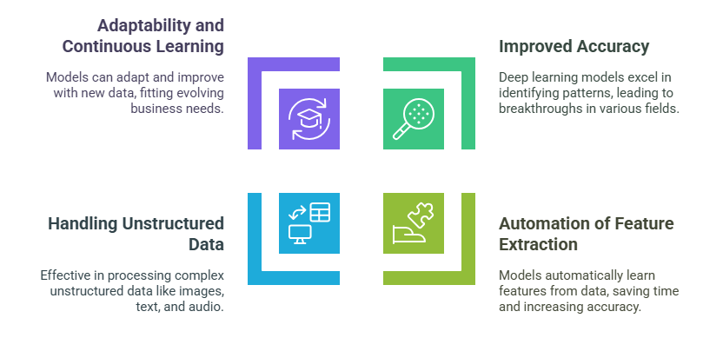
Importance of Deep Learning
Notes:
Improved Accuracy:
Deep learning models have the ability to process huge amounts of data and detect patterns that might be difficult for traditional algorithms to identify. This capability allows deep learning to achieve high accuracy in complex tasks. For example, in computer vision, deep learning powers facial recognition systems, allowing computers to recognize and verify people's identities. In speech recognition, virtual assistants like Siri or Alexa use deep learning to understand spoken commands. Similarly, deep learning enhances natural language processing, enabling chatbots to have meaningful conversations with humans
Automation of Feature Extraction:
One of the key advantages of deep learning is that it eliminates the need for manual feature extraction, which is required in traditional machine learning. In traditional machine learning, experts must decide which aspects of the data are important (known as features) and how to extract them. Deep learning, however, automates this process. The models themselves learn to identify and extract the most relevant features directly from the raw data. This saves time, reduces the need for human expertise, and often leads to better performance because the model can discover features that humans might overlook.
Handling Unstructured Data:
Unstructured data, such as images, text, and audio, is increasingly becoming an important part of AI applications. Traditional machine learning methods struggle to handle this type of data effectively. Deep learning, however, excels at processing unstructured data. For example, deep learning models can analyze images to detect objects, read text from scanned documents, or transcribe and understand spoken language. By efficiently handling unstructured data, deep learning allows AI systems to work with complex real-world information, making them more versatile and useful in a wide range of industries.
Adaptability and Continuous Learning:
Deep learning models have the ability to continuously improve over time as they are exposed to new data. This is a key feature that makes deep learning adaptable to changing environments. For instance, as new data becomes available, deep learning systems can retrain themselves and enhance their performance without needing a complete redesign. This makes them highly valuable in fast-paced industries where requirements and conditions are always evolving, such as finance, healthcare, and e-commerce. By learning from new data, deep learning models can stay up to date and improve their decision-making capabilities.

Slide 5
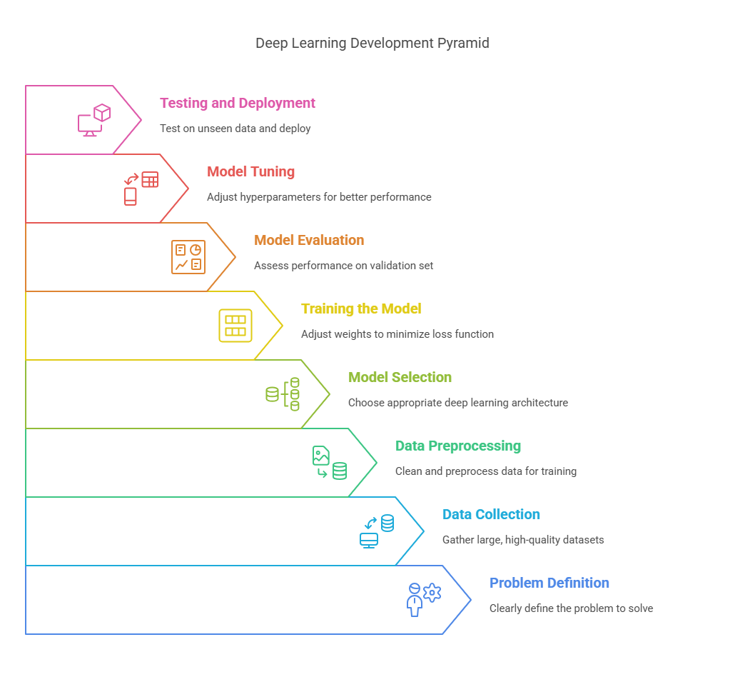
Steps in Deep
Learning Model
Development
Notes:
Problem Definition:
The first step in developing a deep learning model is to clearly define the problem you are trying to solve. This means identifying the task or challenge, such as whether you need to classify images, predict sentiment from text, or recognize speech. The problem definition helps set the direction for the entire process, guiding decisions on data collection, model selection, and performance metrics.
Data Collection:
Once the problem is defined, the next crucial step is to gather large and high-quality datasets. Data is the foundation of deep learning, and having more data generally leads to better performance. The quality of the data matters too; it needs to be relevant and diverse to help the model learn accurately. For example, if you're building an image classification model, you'll need a large set of labeled images to train the model.
Data Preprocessing:
Before the model can be trained, the data must be cleaned and preprocessed. This involves tasks like normalizing data, scaling features, and transforming the data into a form that the model can understand. You must also handle missing data, remove outliers, and ensure that the data quality is high. Data preprocessing is essential because raw data may contain inconsistencies or noise, which can reduce the model’s performance if not addressed.
Model Selection:
The next step is to choose the right deep learning architecture based on the type of problem you're solving. For example, if your problem involves image data, you would likely use a Convolutional Neural Network (CNN). For sequential data like time series or text, a Recurrent Neural Network (RNN) might be more suitable. You will also define the structure of the neural network, including the number of layers, the type of activation functions, and the overall architecture that best suits your data.
Training the Model:
With the data prepared and the model selected, you can start training the model. This step involves feeding the model with training data and adjusting the weights of the neurons to minimize the loss function. Optimization algorithms like Gradient Descent are typically used to adjust these weights during training. The model learns from the data by recognizing patterns and making predictions, gradually improving its performance.
Model Evaluation:
After training the model, you need to evaluate its performance using a separate validation set. This helps ensure that the model is not overfitting to the training data and can generalize well to new, unseen data. Common metrics used for evaluation include accuracy, precision, recall, and F1 score, depending on the type of problem being solved. Evaluating the model on a validation set helps fine-tune the model’s effectiveness.
Model Tuning:
To further improve the model’s performance, hyperparameters such as the learning rate, batch size, and the number of layers need to be tuned. Model tuning involves experimenting with these hyperparameters to find the optimal combination that enhances the model's accuracy and reduces errors. Fine-tuning can significantly impact the overall success of the model.
Testing and Deployment:
Once the model has been trained, evaluated, and tuned, it’s time to test it on unseen data (test set). This helps confirm that the model performs well in real-world scenarios. If the model's performance on the test set meets the desired criteria, it can be deployed for real-world use. Deployment means integrating the model into an application or system where it can make predictions or decisions based on new data.

Slide 6
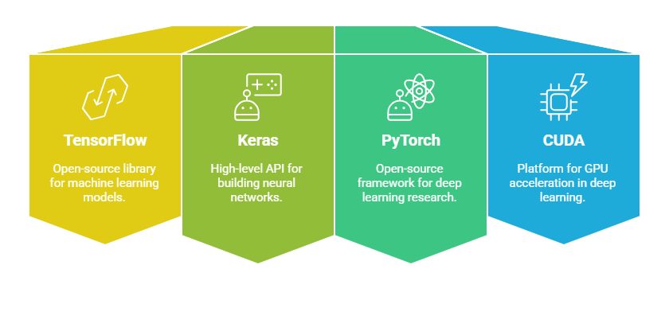
Tools in Deep Learning
Notes:
TensorFlow:
TensorFlow is an open-source software library developed by Google for building and deploying machine learning and deep learning models. It provides a comprehensive and flexible ecosystem, allowing users to create everything from simple models to complex neural networks. TensorFlow supports both CPU and GPU computation, making it efficient for training large models on massive datasets. It’s widely used in production environments and research due to its scalability and reliability.
Keras:
Keras is a high-level neural networks API that runs on top of TensorFlow. It is designed to be user-friendly and easy to use, making it a great choice for beginners and experienced developers alike. Keras allows you to quickly build, train, and evaluate deep learning models with less code and complexity compared to using TensorFlow directly. It’s perfect for rapid prototyping and experimentation, enabling users to focus more on the model design rather than the underlying technical details.
PyTorch:
PyTorch is another open-source deep learning framework, developed by Facebook. It is known for its flexibility and efficiency, particularly in research and experimentation. PyTorch uses dynamic computation graphs, which makes it more intuitive and easier to debug than some other frameworks. It’s highly favored by researchers due to its flexibility, and it also supports GPU acceleration, making it efficient for training large models. PyTorch is gaining popularity in the deep learning community for its ease of use and strong community support.
CUDA:
CUDA (Compute Unified Device Architecture) is a parallel computing platform and API model created by NVIDIA. It allows developers to use NVIDIA GPUs (Graphics Processing Units) for general-purpose computing tasks, including deep learning. By leveraging GPU acceleration, CUDA significantly speeds up the training of deep learning models. This is particularly important for deep learning tasks, which involve large datasets and complex computations that benefit from the parallel processing capabilities of GPUs.

Slide 7
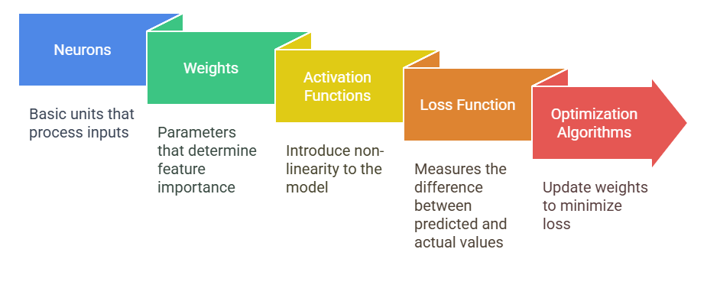
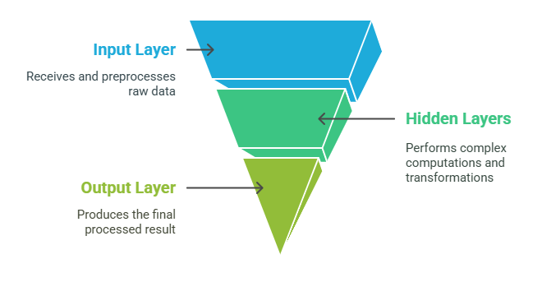
Elements of Deep Learning
Notes:
Neurons:
Neurons are the basic units of a neural network. Just like the human brain, neurons receive inputs, apply a mathematical function to these inputs, and pass the result to the next layer in the network. Each neuron takes in data, processes it, and helps the network make decisions. In a deep learning model, multiple neurons work together in layers to recognize patterns and make predictions.
Layers:
A neural network is made up of different layers:
Input Layer: This layer receives the raw data. It’s where the data is fed into the network, like images, text, or numbers.
Hidden Layers: These are the layers between the input and output layers. Hidden layers are where most of the computations take place, and they help the network learn complex patterns in the data.
Output Layer: The output layer produces the final result or prediction. For example, in a classification task, this layer might tell you which category an image belongs to.
Weights:
Weights are parameters that are learned during the training process. They determine how much influence each input feature has on the final result. During training, the network adjusts the weights to minimize errors and improve predictions. Think of weights as a way to measure the importance of each input when making decisions.
Activation Functions:
Activation functions are mathematical functions that introduce non-linearity into the network, allowing it to learn complex patterns. Without these functions, the network would only be able to learn linear relationships, which are too simple for many tasks. Some common activation functions are:
ReLU (Rectified Linear Unit): Allows positive values to pass through while setting negative values to zero.
Sigmoid: Converts input values into probabilities, useful for classification tasks.
Loss Function:
The loss function measures how far the model’s predictions are from the actual results. The goal during training is to minimize this loss. For example, if the model is trying to predict a number (regression), the loss function might be Mean Squared Error (MSE). If the model is classifying items into categories (classification), the Cross-Entropy Loss is often used. A smaller loss indicates that the model is making more accurate predictions.
Optimization Algorithms:
Optimization algorithms, such as Gradient Descent, are used to update the model's weights during training. These algorithms help minimize the loss function by adjusting the weights in the direction that reduces the error. The better the optimization, the faster the model learns and improves its performance.

Slide 8
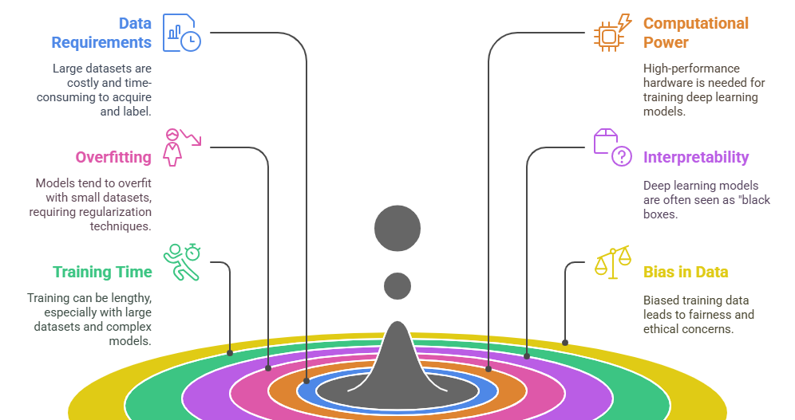
Challenges in Deep Learning
Notes:
Data Requirements:
Deep learning models require vast amounts of high-quality data to perform well. Collecting and labeling this data can be very expensive and time-consuming. Without sufficient data, models may not learn the patterns effectively, resulting in poor performance.
Computational Power:
Training deep learning models can be computationally intensive, as it involves processing large datasets and performing complex calculations. To handle this, high-performance hardware, like GPUs (Graphics Processing Units) or TPUs (Tensor Processing Units), is often necessary. These hardware devices are designed to process large amounts of data quickly, making the training process more efficient.
Overfitting:
Overfitting occurs when a model learns the training data too well, including noise and outliers, which can lead to poor performance on new, unseen data. This means the model is too specific and doesn’t generalize well. Regularization techniques, such as dropout (randomly turning off certain neurons) and early stopping (halting training when performance stops improving), are used to prevent overfitting.
Interpretability:
Deep learning models are often described as "black boxes" because it’s hard to understand exactly how they make decisions. Unlike simpler models, deep learning models involve many layers of complex computations, making it difficult to interpret why a particular decision was made. This lack of transparency can be a challenge, especially when the model's decision needs to be explained or trusted.
Training Time:
Training deep learning models can be very time-consuming, especially when dealing with large datasets or complex models. The more data and layers the model has, the longer it takes to train. This can be frustrating, especially when you need quick results or need to experiment with different model configurations.
Bias in Data:
If the training data contains biases, the model will learn and replicate those biases, leading to unfair or unethical outcomes. For example, if a facial recognition system is trained mostly on images of people from one demographic group, it may perform poorly for other groups. Ensuring diverse, representative data is critical to avoiding biased results and promoting fairness in AI systems.

Slide 9
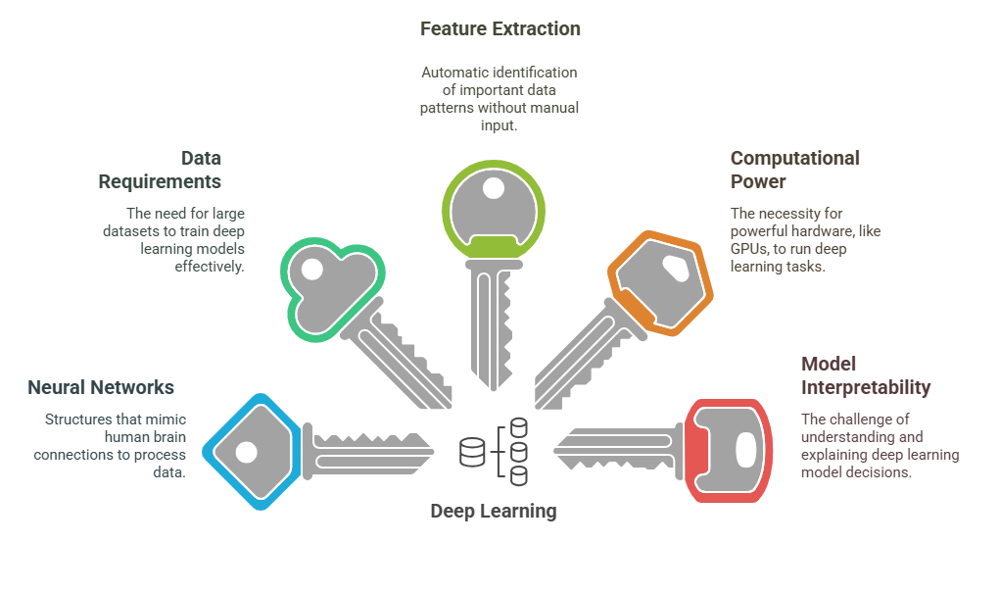
5 Key Learning Points of this Lesson
Notes:
Deep learning is a subset of machine learning that uses multi-layered neural networks to model complex patterns in large datasets. Unlike traditional machine learning algorithms, deep learning models can automatically learn from data and improve over time without needing explicit instructions. These neural networks have multiple layers that help them process and analyze data at different levels, allowing them to recognize complex patterns that simpler models might miss.
Deep learning excels in tasks like image recognition, speech processing, and natural language understanding, requiring large datasets and computational power. For tasks like identifying objects in images, deep learning models are particularly effective due to their ability to learn from vast amounts of data. However, deep learning's need for large datasets and high computational resources makes it challenging to deploy for every problem, especially those with limited data.
Unlike machine learning, deep learning automatically extracts features from raw data, eliminating the need for manual feature engineering. In machine learning, experts need to manually identify and select important features in the data for the model to learn from. With deep learning, the model automatically discovers relevant features during training, reducing the need for domain knowledge and making the process faster and more efficient.
Deep learning models are computationally intensive, often requiring specialized hardware like GPUs for training. These models involve complex calculations and large datasets, which can be too slow for conventional processors. GPUs, which are designed to handle many operations in parallel, significantly speed up the training process and are crucial for handling the scale of deep learning tasks.
While deep learning models offer high accuracy, they can be challenging to interpret due to their complexity and "black box" nature. The multiple layers in deep learning models make it difficult to understand exactly how decisions are made, as the process involves intricate computations. This lack of interpretability is a significant challenge when trying to apply deep learning in areas where understanding the reasoning behind decisions is crucial, such as healthcare or law.

Slide 10
Thank You!
Shahriar’s Analytical Academy

